Slide 1
Zebra Mussel Discussion
Eleventh Crow Wing Lake, Akeley MN
Sunday Oct 4th, 2026
10th / 11th Crow Wing Lakes Association
Website: Crowwing11.org
Private Facebook Page: 10th and 11th Crow Wing Lakes Association

Slide 2
Agenda
Background / Discovery
DNR Press Release
What are Zebra Mussels; Article by Dr Bruce Carlson
Treatment Options
Containment Priorities
10th Crow Wing Impact; Other Downstream Crow Wing Lakes
Area Lakes with Zebra Mussels
  Water quality changes, impacts, property values
Resources
Questions & Group Discussion
19 slides

Slide 3
Background & Discovery
Since early 2010’s, our lake association has funded additional paid inspection hours at the boat ramp. We have great partners in City of Akeley and Akeley Township in funding these hours. More paid hours ($3000+/yr and COLA Hours) than most lakes of our size. We have additionally funded voluntary zeba mussel sampling for veligers (the tiny offspring) for 5-8 years on Eleventh Crow Wing
Through a connection with downstream Crow Wing Lake Associations, we heard of likely Zebra Mussel issue in Eleventh Crow Wing (9/28). A call was placed to Gina Kemper, our DNR area AIS (aquatic invasive specialist) contact. She confirmed approximately 2 dozen zebra mussels were on a resident pontoon boat near the access. And additional zebra mussels were found at two properties on the north shore including one dock

Slide 4
DNR Press Release – Oct 1st, 2026
Zebra mussels confirmed in Sauer Lake in Becker County, Eleventh Crow Wing Lake in Hubbard County
The Minnesota Department of Natural Resources has confirmed the presence of zebra mussels in Sauer Lake, near Detroit Lakes in Becker County, and Eleventh Crow Wing Lake, near Akeley in Hubbard County.
At Saurer Lake, a lake property owner contacted the DNR after finding zebra mussels attached to a boat being removed from the lake for the season. A DNR invasive species specialist found zebra mussels at the Sauer Lake public water access, about 300 feet from the location of the initial report.
At Eleventh Crow Wing Lake, it was Hubbard County staff that contacted the DNR after a county watercraft inspector found zebra mussels on a boat being removed from the lake for the season. DNR invasive species staff found additional zebra mussels at the public water access.
Several new zebra mussel populations in Minnesota lakes in recent years were first reported by property owners and lake service providers as they removed docks, boats and boat lifts at the end of the season. It is a good reminder to carefully check boats and trailers, docks and lifts, and all other water-related equipment for invasive species when removing them for seasonal storage.
Whether or not a lake has any invasive species, Minnesota law requires people to:
Clean watercraft, trailers and equipment to remove aquatic plants and prohibited invasive species.
Drain all water and leave drain plugs out during transport.
Dispose of unwanted bait in the trash.
Never release bait, plants or aquarium pets into Minnesota waters.
Dry docks, lifts and rafts for 21 days before moving them from one water body to another.

Slide 5
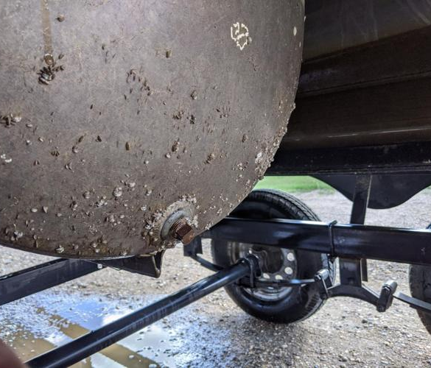
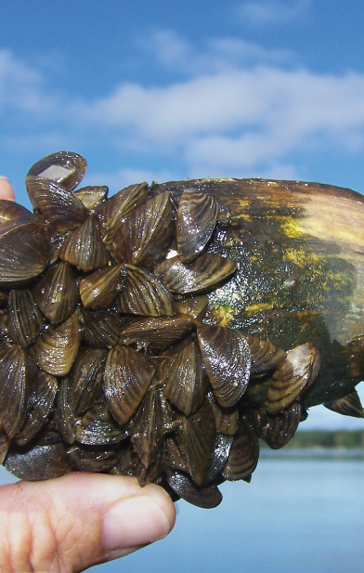
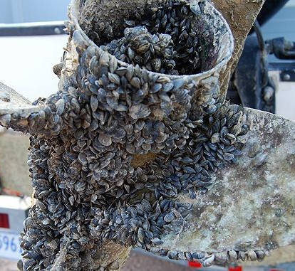
What are Zebra Mussels?
How did they get here?
  Native in freshwater basins in Eastern Europe/Western Russia (Black and Caspian Seas), they were introduced to the United States via ballast from transoceanic cargo ships. First found in Lake St Clair in MI, connected to Lake Huron and Lake Erie. After infesting all 5 Great Lakes it quickly spread to rivers and other lakes
How do they impact our lake?
  Filter out plankton which changes food chain; increased water clarity; can increase phosphorus with excrement
  Can cause plant growth in deeper water due to improved clarity
  Attaches to rocks and hard surfaces such as boats, propellers, ladders, swim platforms, lifts, and docks
  Can be a nuisance as dead mussel shells are sharp; harder to walk on beach areas

Slide 6
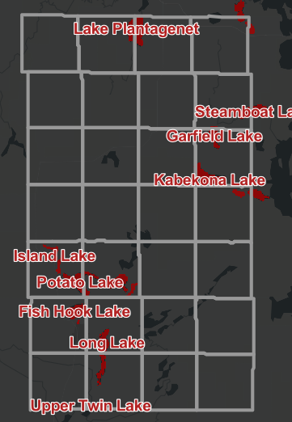
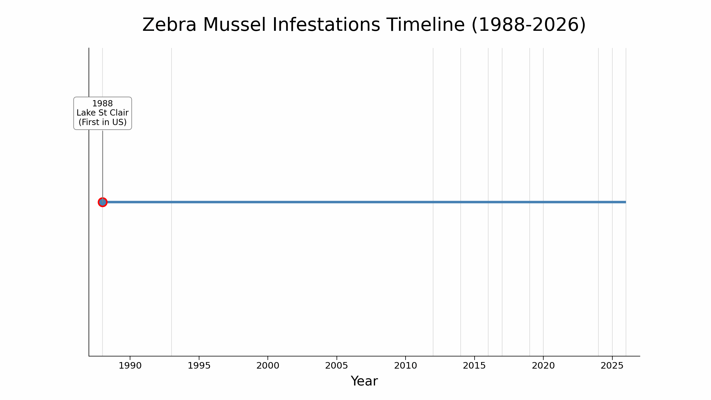
But How Did They Get in 11th Crow Wing?
Impossible to say. Likely came on a boat, trailer, or lakeshore equipment (dock/lift). Bilge and livewell areas are prime suspects as they could contain the microscopic veligers (baby ZM’s)
Here is an animation of the progression of Zebra Mussels starting from introduction in the United States, and the march across area lakes which includes anchor lakes (large lakes that draw anglers/boaters) and lakes infested within Hubbard County

Slide 7
Dr Bruce Carlson Article
You can find and read his article by searching for “zebra mussel Dr Bruce Carlson”
  Academic who studied in Minnesota, earning various degrees including a PhD-MD from Univ of Minnesota studying limb regeneration in salamanders
  Summer home on nearby Ten Mile Lake in Hackensack
  Since retirement in 2006, Bruce has reverted to his scientific childhood and has again taken up work on fish and lake biology. In addition to weekly collections of data about the lake by his cabin, he has directed a ten-year study on the growth of northern pike on a nearby lake and has spent hundreds of hours taking underwater videos in northern lakes. This activity has led to his writing two popular books on lake biology and one on aquatic invasive species.

Slide 8
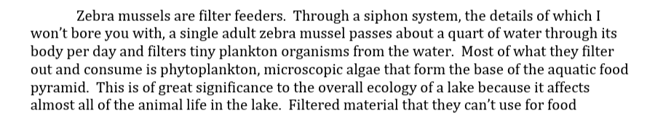
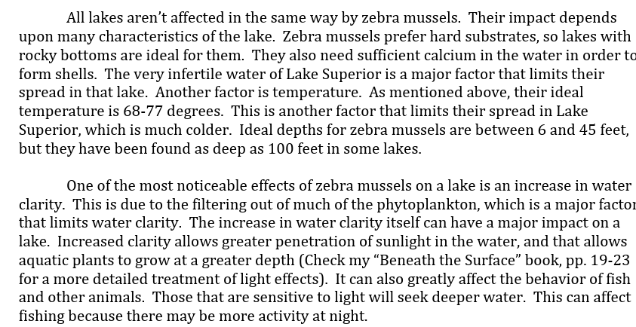
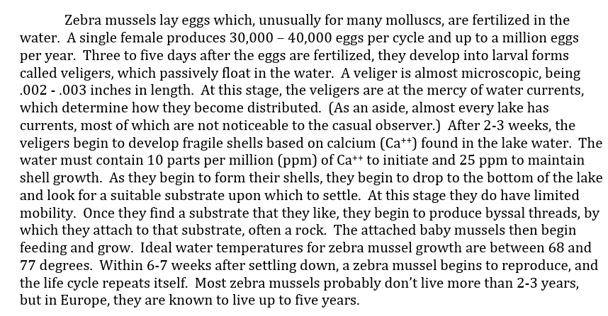
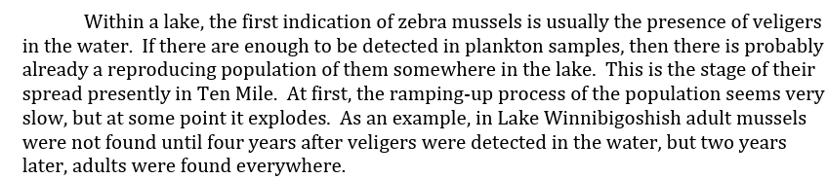
Excerpts from his Article

Slide 9
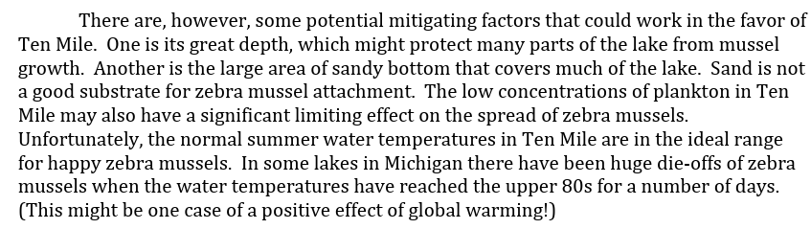
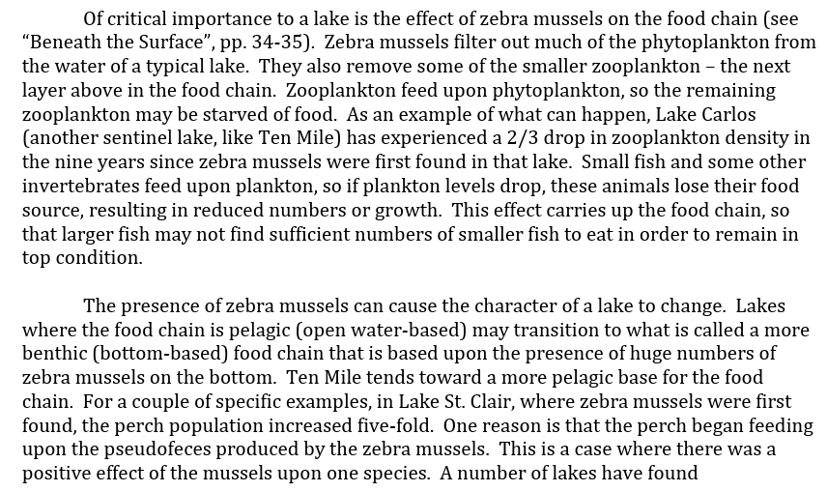
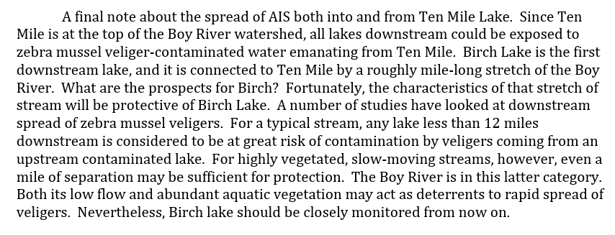
Excerpts, Part 2

Slide 10
Treatment Options
Treatment options are limited, and our AIS specialist did not express hope that any would have success. Because there were multiple indications of adult zebra mussels, and they were located at various points in the larger west basin, localized containment is very unlikely/impossible. Treatment costs are expensive ($9300 in localized Christmas Lake case study in MN)
Many of our surrounding lakes were found by positive test result for veligers, the microscopic babies. We have actual adult zebra mussels that are likely already reproducing. They may have been present for more than a year without anyone noticing

Slide 11
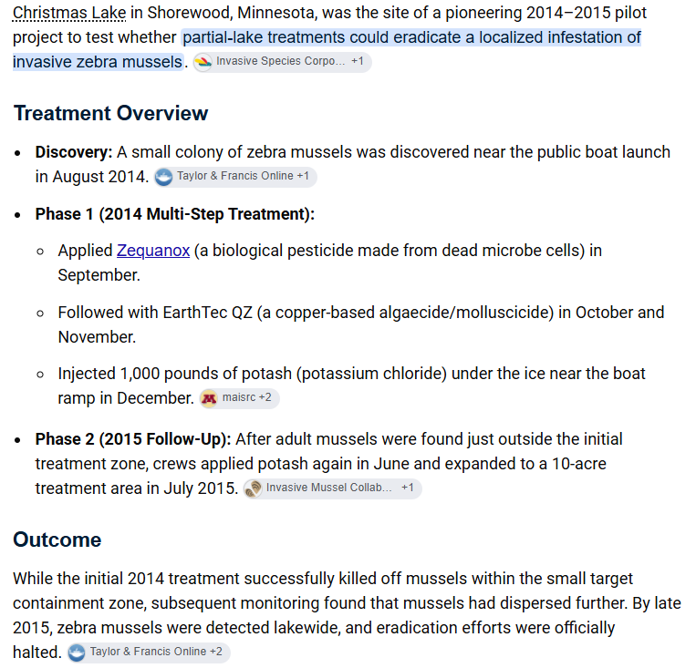
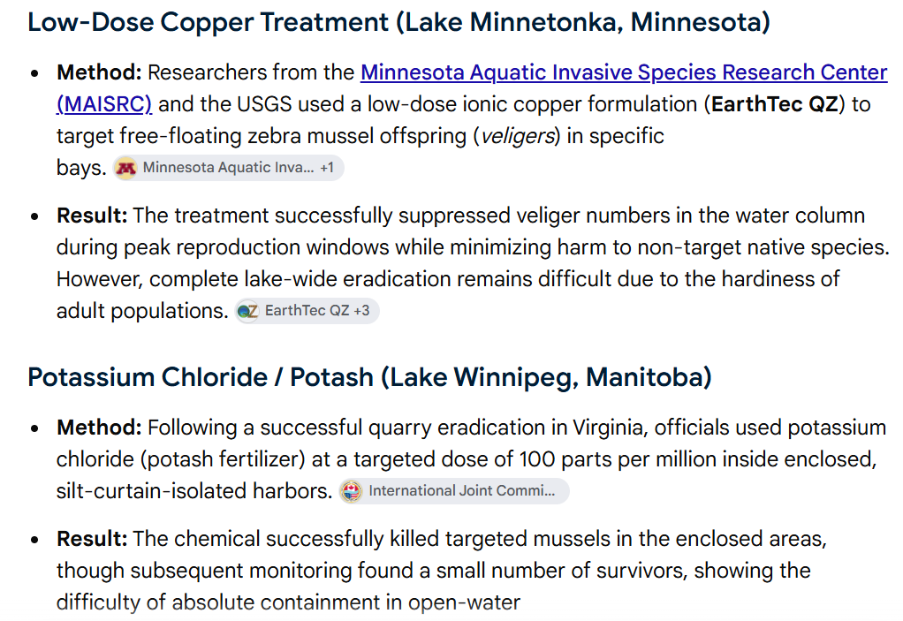
Treatment Options, Cont’d

Slide 12
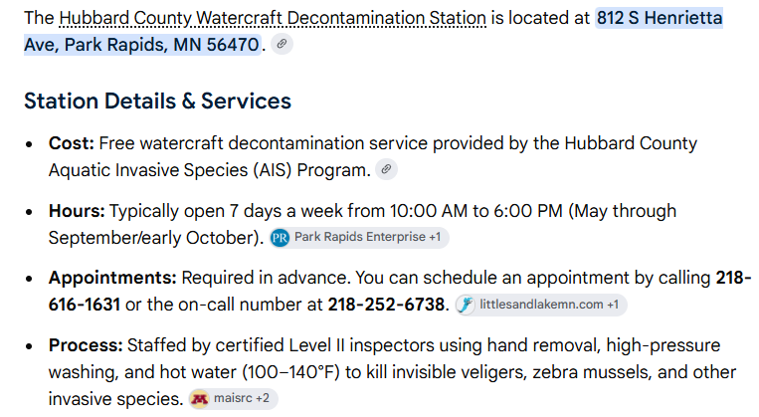
Containment Options
We should continue posting a boat inspector at 11th Crow Wing to discourage the spread of Zebra Mussels to other area lakes
Assume DNR will post specific bright colored signage of Zebra Mussel infestation (have seen orange signs at lakes like Garfield)
Need to post address of decontamination station in Park Rapids

Slide 13
Containment Cont’d
Lakeshore providers (people who move docks and lifts in and out of the lake as a paid service) should be immediately notified by owner if they are taking docks and lifts out for the season. If they use a pontoon boat with forks, the boat will have to be decontaminated before shifting to next lake. They have to undergo AIS specific training so they should know this; however they may have not yet heard about 11th CW as ZM
Any sale of lakeshore equipment, boats, or other should be dry for 21 days as provided by DNR. This allows time for the zebra mussels to dry out and die
Be so extra, extra careful if you take your boat out of 11th and potentially travel to other lakes. We do not want the same thing that happened to us to happen to others

Slide 14
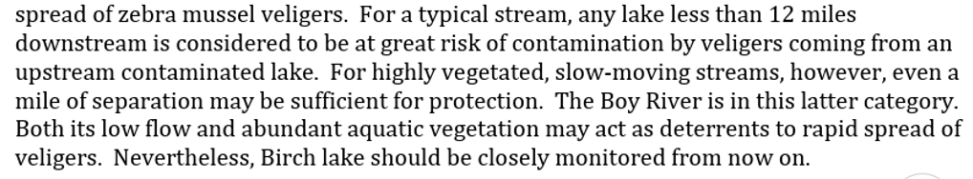
10th Crow Wing Impact; Other downstream CW lakes
Internet research says 2 miles from outlet of Eleventh to inlet of Tenth Crow Wing Lakes
Dr Carlson suggested that:
Question out to DNR AIS Specialist if there are any stream containment options. The veligers are .002 - .003” in size, so any type of filtration would likely plug up flow immediately
Recommend switching monitoring dollars in L.A. from Eleventh to Tenth Crow wing. Need a volunteer for this to take monthly samples to Park Rapids (during the week)

Slide 15
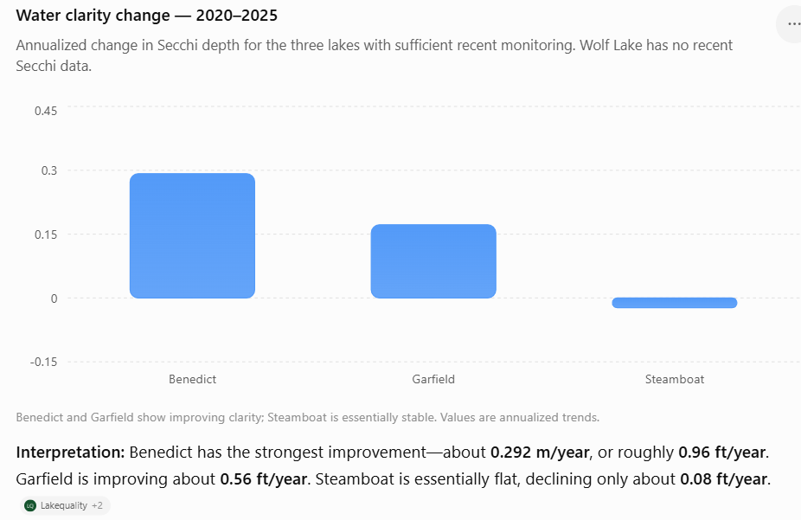
Area Lakes with Zebra Mussels
What can we learn from their experiences?
All three were reported in 2017 w/ Zebra Mussels

Slide 16
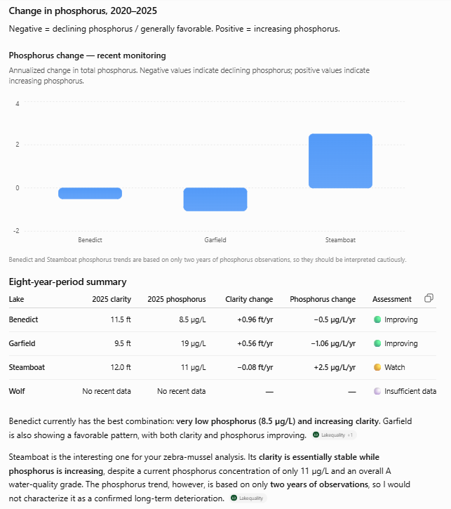
Area Lakes Cont’d

Slide 17
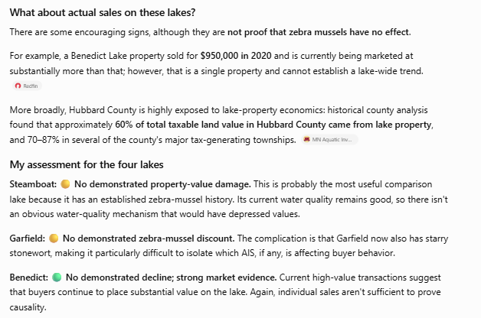
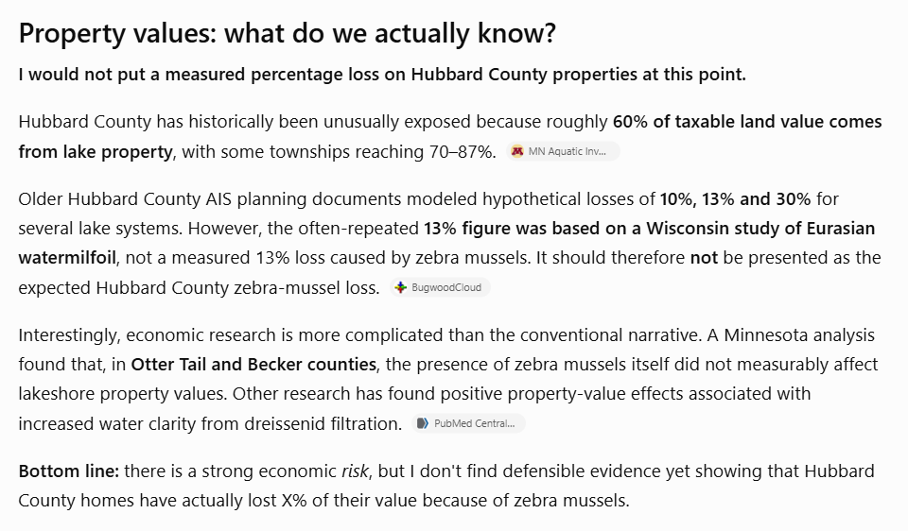
Area Lakes Cont’d

Slide 18
Resources
DNR Zebra Mussel Link:
  Zebra mussel (Dreissena polymorpha) | Minnesota DNR
Dr Carlson Article, Zebra Mussel
  11-22-19+Zebra+Mussels.pdf
Current Distribution of Hubbard Cty Lakes with Zebra Mussels:
  Zebra Mussel | Hubbard County Aquatic Invasive Species Tracker

Slide 19
Questions & Group Discussion

